Slide 1

PHS650: Rigor and Reproducibility in the Social, Behavioral, and Population Health Sciences
Dr. Katherine Schaumberg
Wk 2 – Git it together

Slide 2
WHY Git?
Vertical versioning
Sane code collaboration
Organized project repository for reproducible science
E.g. end goal:
https://github.com/kschaumb/alspac-dex-1-bookdown

Slide 3
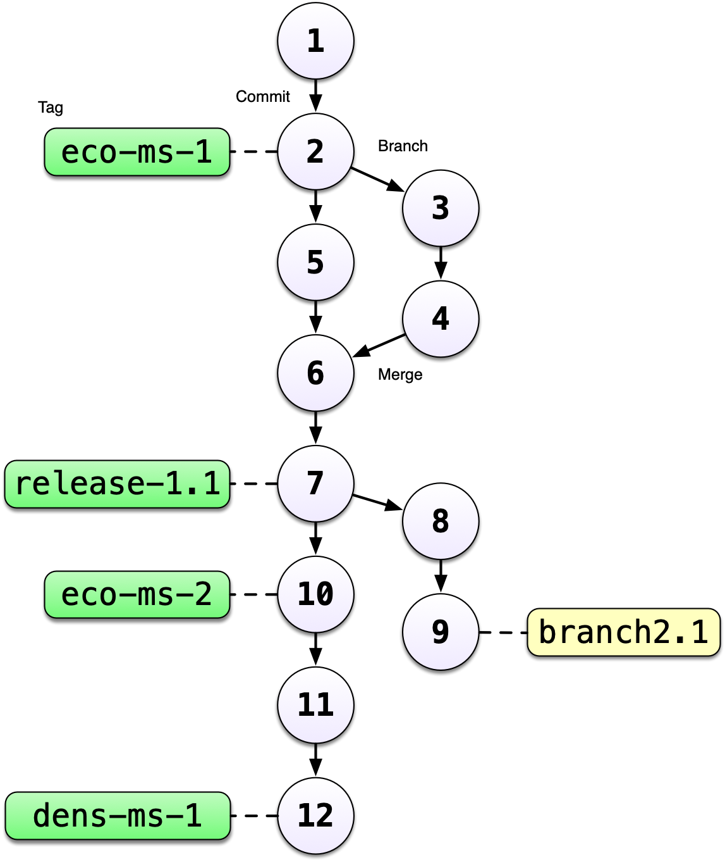
Vertical versioning
NEVER lose an old copy of your work
ONE master/most recent version – updated to be the ‘newest’ version with each commit
File names DON’T change
People can be working on different files/branches - which then are merged back together

Slide 4
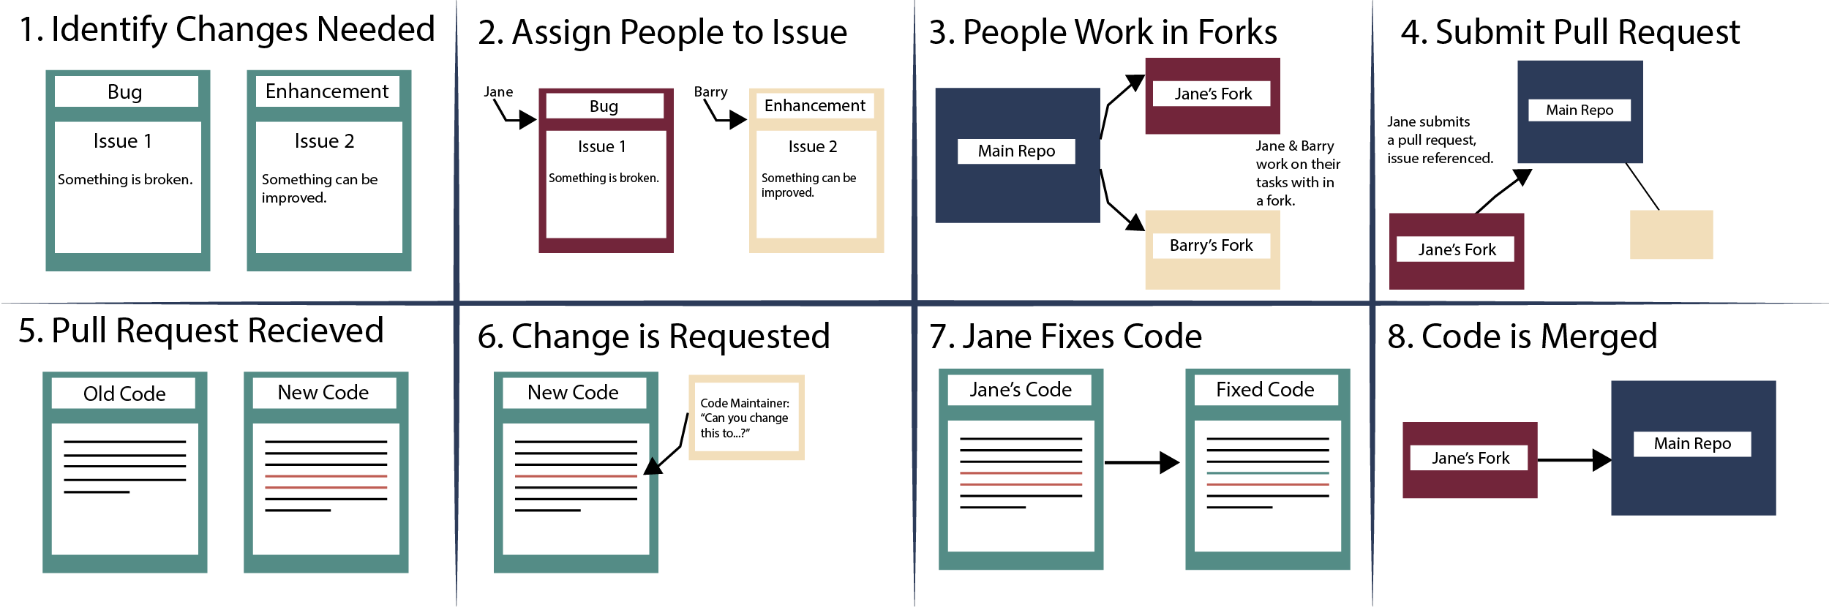
Code Collaboration

Slide 5
Organized Repository for Reproducibility
https://github.com/kschaumb/alspac-dex-1-bookdown

Slide 6
GitHub Demo
Connect your RStudio with Git
Start a Repository in GIt
Start an R project
Connect your repository with the project
The .gitignore file
Pull
Commit
Push

